Slide 1

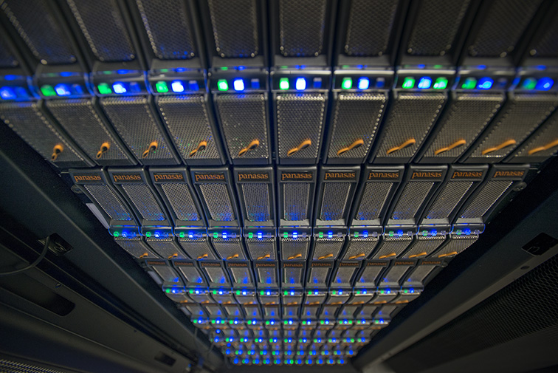


Required Data Centre and Interoperable Services: CEDA
JASMIN (STFC/Stephen Kill)
Philip Kershaw, Victoria Bennett, Martin Juckes, Bryan Lawrence, Sam Pepler, Matt Pritchard, Ag Stephens

Slide 2
CEDA, JASMIN and UK Research Councils
CEDA is part of STFC and runs data centres on behalf of NERC

Slide 3
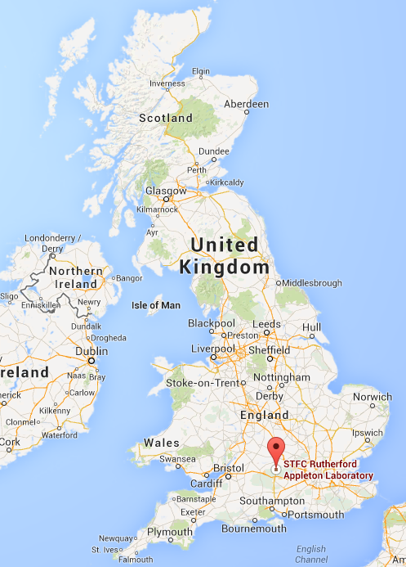
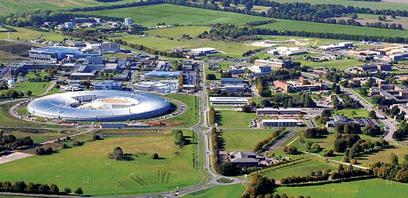
Centre for Environmental Data Analysis
JASMIN facility
CEDA
CEDA’s mission, “to support environmental science, further environmental data archival practices, and develop and deploy new technologies to enhance access to data”
curation and facilitation

Slide 4
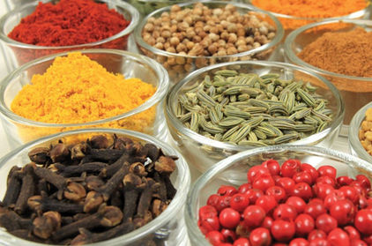

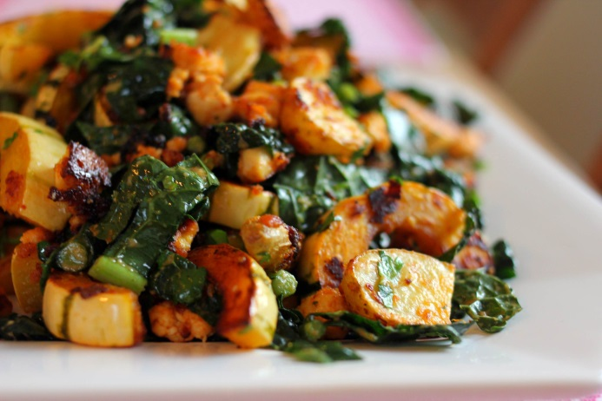
Data Science and Food Analogy
Quality ingredients (organised and discoverable)
Suitable tools, and a plan (recipe) and experts (well trained people)
Wide variety of products targeted for different consumers
Quality data (organised and discoverable)
Suitable platforms, and algorithms and experts (well trained people)
Wide variety of products targeted for different consumers
(Slide courtesy of Bryan)

Slide 5
CEDA + JASMIN Functional View

Slide 6
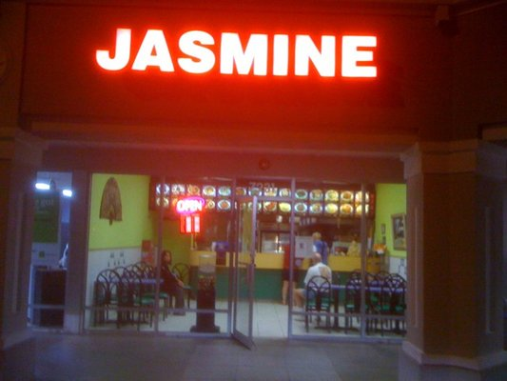

JASMIN
Petascale storage, hosted processing and analysis facility for big data challenges in environmental science
16PB high performance storage (~250GByte/s)
High-performance computing (~4,000 cores)
Non-blocking Networking (> 3Tbit/sec), and Optical Private Network WAN’s
Coupled with cloud hosting capabilities
For entire UK NERC community, Met Office, European agencies, industry partners
You can get food ready made but you can also go into the kitchen and make your own (IaaS) ☺
JASMIN (STFC/Stephen Kill)

Slide 7
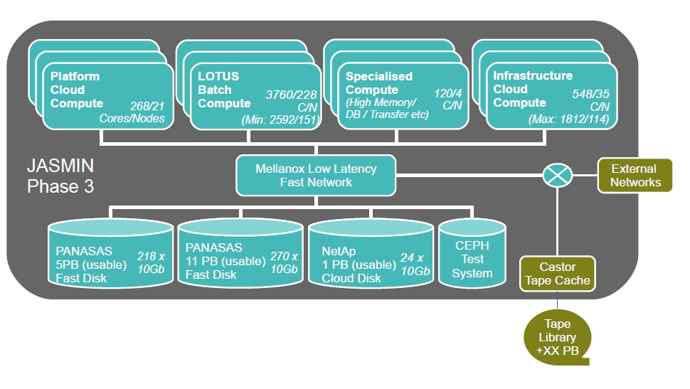
JASMIN
Four services provided to the community:
Storage (disk and tape)
Batch computing (“Lotus”)
Hosted computing
Cloud computing

Slide 8
Challenges
Big data V’s:
volume and velocity
Variety (complexity)
How to provide a holistic cross-cutting technical solution for
performance
multi-tenancy
flexibility + meet needs of the long-tail of science users
All the data available all of the time
Maximise utilisation of compute, network and storage (the ‘Tetris’ problem)
With an agile deployment architecture

Slide 9
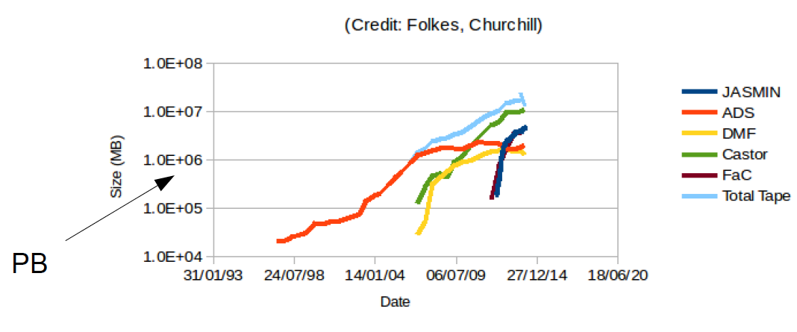
Volume and Velocity: Data growth
(Large Hadron Collider Tier 1 data on tape)
(at STFC)
JASMIN 3 upgrade addressed growth issues of
disk, local compute, inbound bandwidth
Looking forward, disk + nearline tape storage will be needed
Cloud-bursting for compute growth?

Slide 10
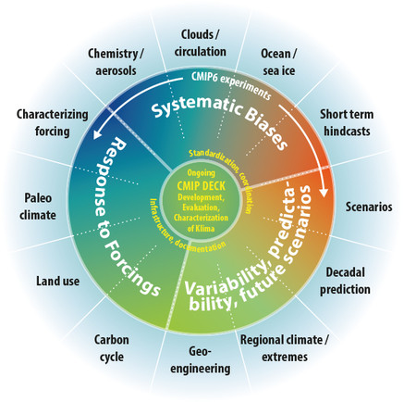
Volume and Velocity: CMIP data at CEDA
For CMIP5, CEDA holds 1.2 Petabytes of model output data
For CMIP6:
“1 to 20 Petabytes within the next 4 years”
Plus HighresMIP:
10-50 PB of Hiresmip data … on tape
2 PB disk cache
Archive growth not constant
depends on timeline of outputs available from model centres
Schematic of proposed experiment design for CMIP6

Slide 11
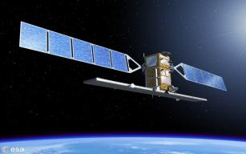
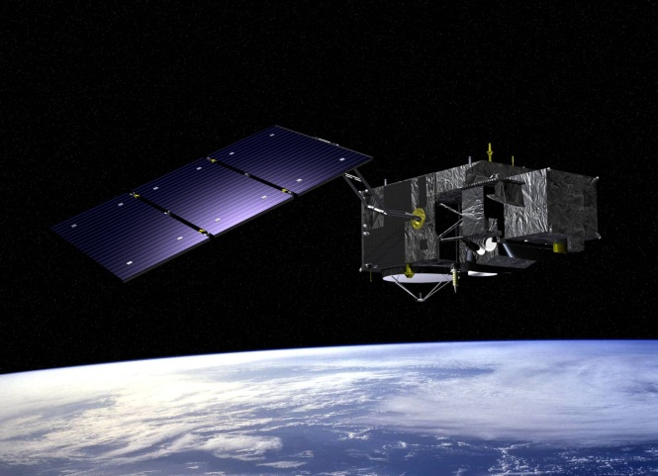
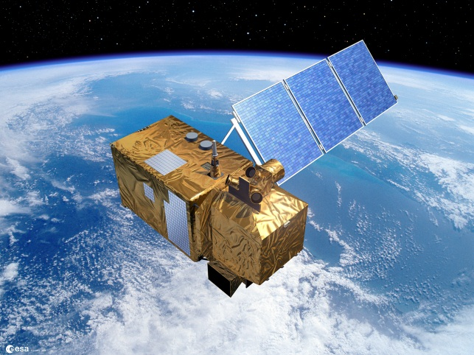
Volume and Velocity: Sentinel Data at CEDA
New family of ESA earth observation satellite missions for the Copernicus programme (formerly GMES)
CEDA will be UK ESA relay hub
CEDA Sentinel Archive:
Recent data (O)6-12 months stored on-line
Older data stored near-line
Growth is predictable over time
S-1A, launched 3rd April 2014
Mission | Daily data rates | Product archive/year
Sentinel 1A, 1B | 1.8 TB/day raw data | 2 PB/year
Sentinel 2A | 1.6 TB/day raw data | 2.4 PB/year
Sentinel 3A | 0.6 TB/day raw data | 2 PB/year
S-2A, launched 23rd June 2015
S-3A expected Nov 2015
Expected 10 TB/day when all missions operational
Notes:
Copernicus joint EU and ESA initiative to ensure timely and easily accessible information to improve the management of the environment, understand and mitigate the effects of climate change and ensure civil security

Slide 12
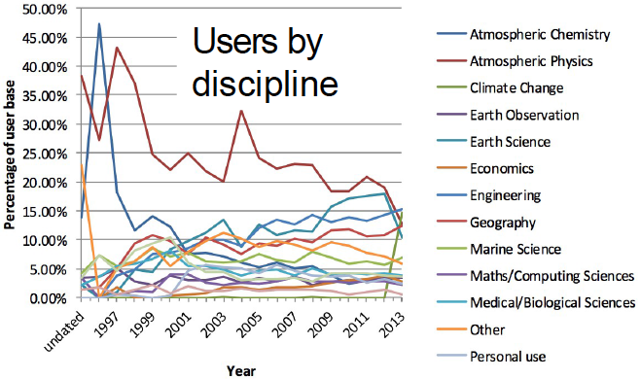
Variety (complexity)
Headline figures
3PB archive
~250 datasets
> 200 million files
23000 registered users
Projects hosted using ESGF:
CMIP5, SPECS, CCMI, CLIPC and ESA CCI Open Data Portal
ESGF faceted search and federated capabilities are powerful but . . .
need to have effective means to integrate other heterogeneous sources of data
All CEDA data hosted through common
CEDA web presence
MOLES metadata catalogue
OPeNDAP (PyDAP)
FTP
CEDA user base has been diversifying

Slide 13
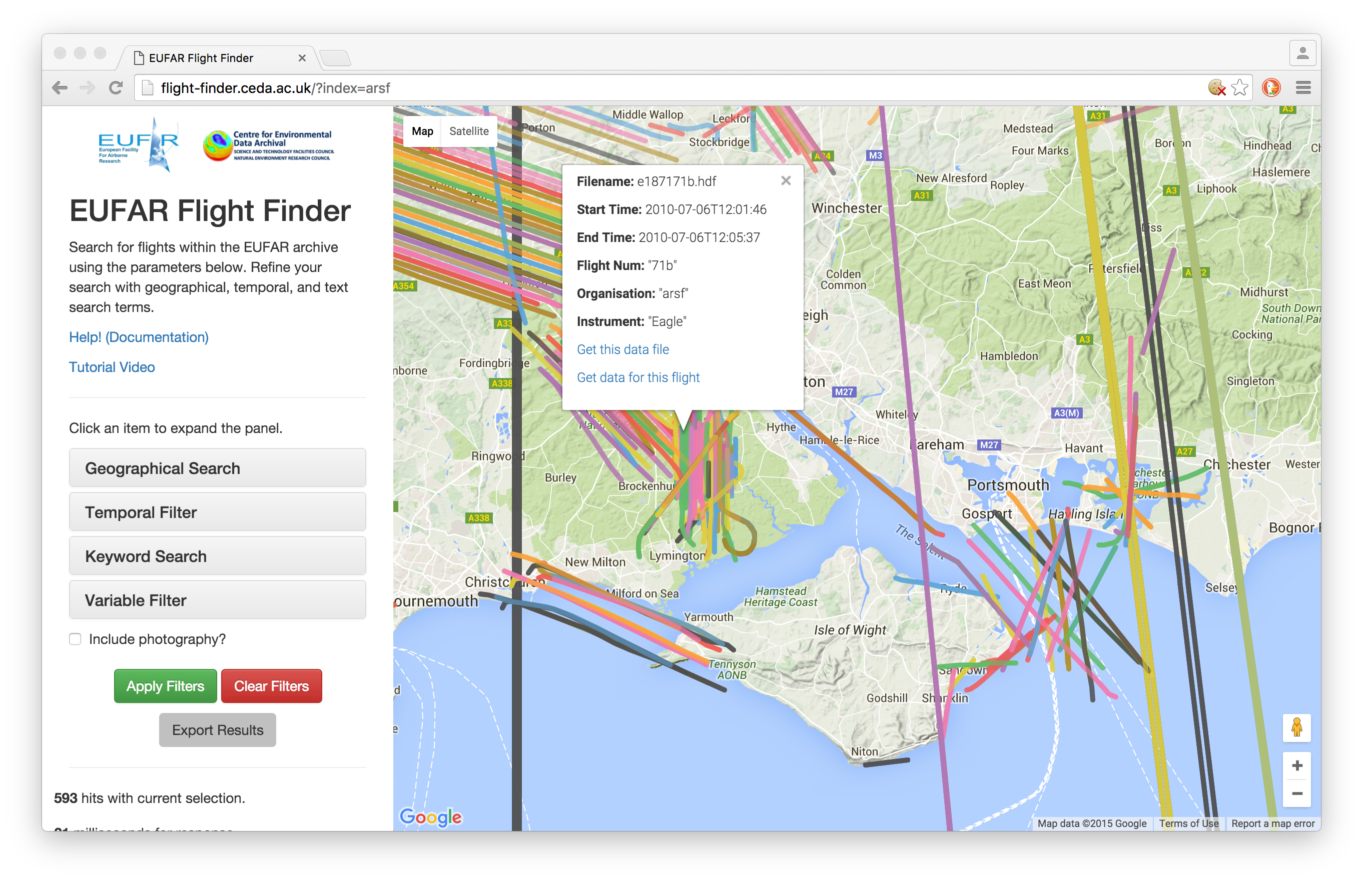
Variety example 1: ElasticSearch project
Indexing file-level metadata using Lotus cluster on JASMIN
3PB
~250 datasets
> 200 million files
Phases
File attributes e.g. checksums
File variables
Geo-temporal information
An OpenSearch façade will be added to CEDA ElasticSearch service to provide ESA-compatible search API for Sentinel data
EUFAR flight finder project piloted use of ElasticSearch
Heterogeneous airborne datasets
Transformed accessibility of data

Slide 14
Variety example 2: ESA CCI Open Data Portal
ESA Climate Change Initiative
responds directly to the UNFCCC/GCOS requirements, within the internationally coordinated context of GEO/CEOS.
The Global Climate Observing System (GCOS) established a list of Essential Climate Variables (ECVs) that have high impact.
Goal is to provide a single point of access to the subset of mature and validated ECV data products for climate users
CCI Open Data Portal builds on ESGF architecture
But datasets are very heterogeneous not like well behaved model outputs ;-) . . .
Notes:
The ESA Earthwatch programme element “Global Monitoring of Essential Climate Variables” (GMECV)
United Nations Framework Convention on Climate Change (UNFCCC) concerns systematic observation and development of data archives related to the climate system.
The Global Climate Observing System (GCOS, established 1992)

Slide 15




CCI Open Data Portal Architecture
Data discovery and other user services
ISO Records are tagged with appropriate DRS terms to link CSW and ESGF search results
Data download for user community
User Interface
Web Presence
Consumed by web user search interface
Apply Access Policy and Logging and Auditing
Search services
OGC CSW
ESGF Index Node
Data Download Services
SPARQL Interface
ESGF Data Node
GridFTP
THREDDS
FTP
OPeNDAP
WCS
WMS
Vocabulary Server
ISO19115 Catalogue
Create Solr Index
Catalogue Generation
Single point of reference for CCI DRS.
DRS is defined with SKOS and OWL classes
Create ISO Records
Data ingest
CCI Data Archive
Quality Checker
ESG Publisher

Slide 16
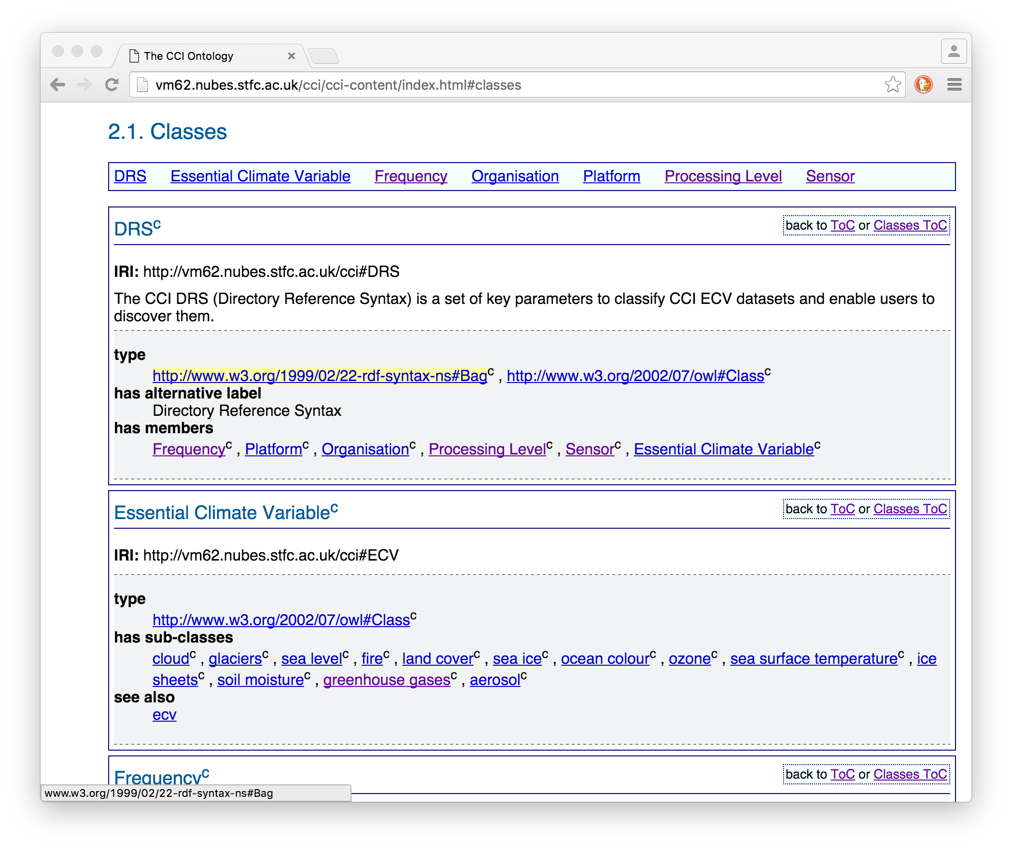
CCI Open Data Portal: DRS Ontology
Specifies DRS vocabulary for the CCI project
Could be applied to other ESGF projects
Some terms are common to CMIP5 such as organisation and frequency
Specific terms are added for CCI such as Essential Climate Variable
SKOS allows expression of relationships with similar terms

Slide 17



JASMIN Evolution 1)
JASMIN Cloud
HTC (High throughput Computing)
Success through recognition workloads io bound
Storage and analysis
Global file system
Group work spaces exceed space taken by curated archive
Data Archive and compute
Bare Metal Compute
High performance global file system
Virtualisation
Internal Private Cloud
Virtualisation
Flexibility and simplification of management
<= Different slices thru the infrastructure =>
Cloud
Isolated part of infrastructure needed for IaaS: users take full control of what they want installed and how
Flexibility and multi-tenancy . . .
Isolated part of the network
Support a spectrum of usage models

Slide 18
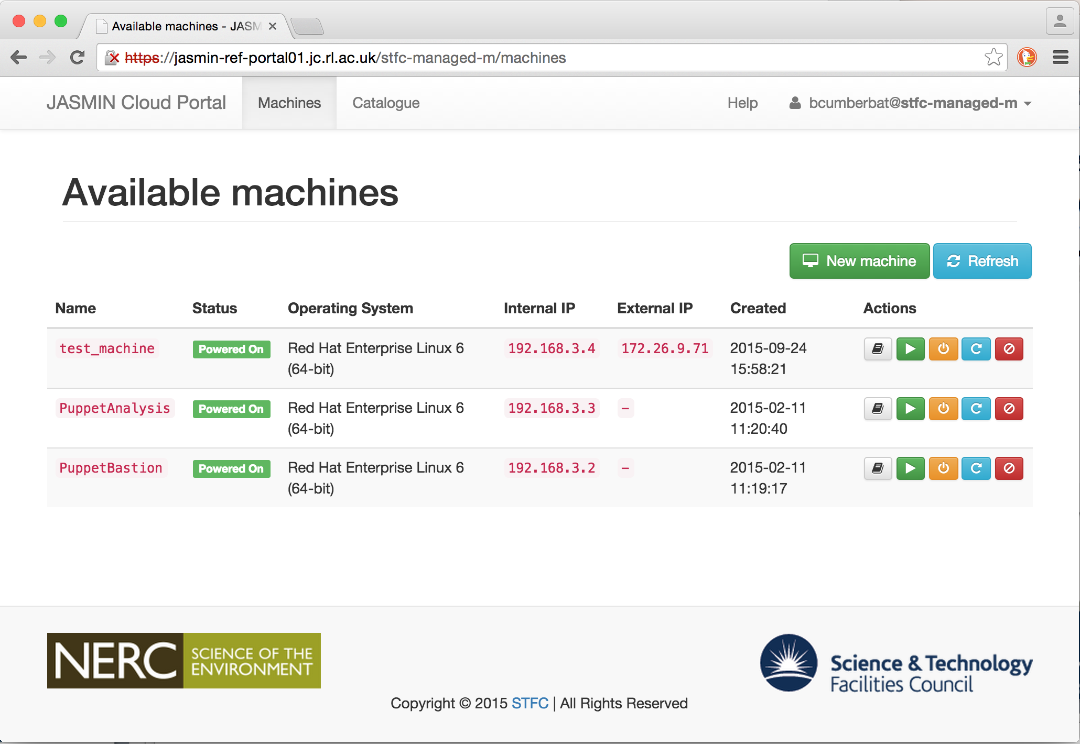
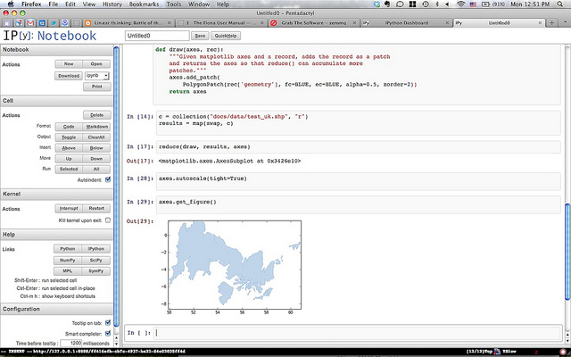
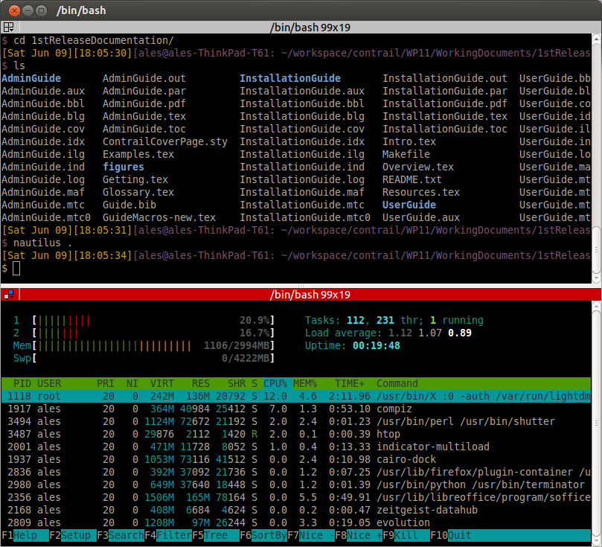
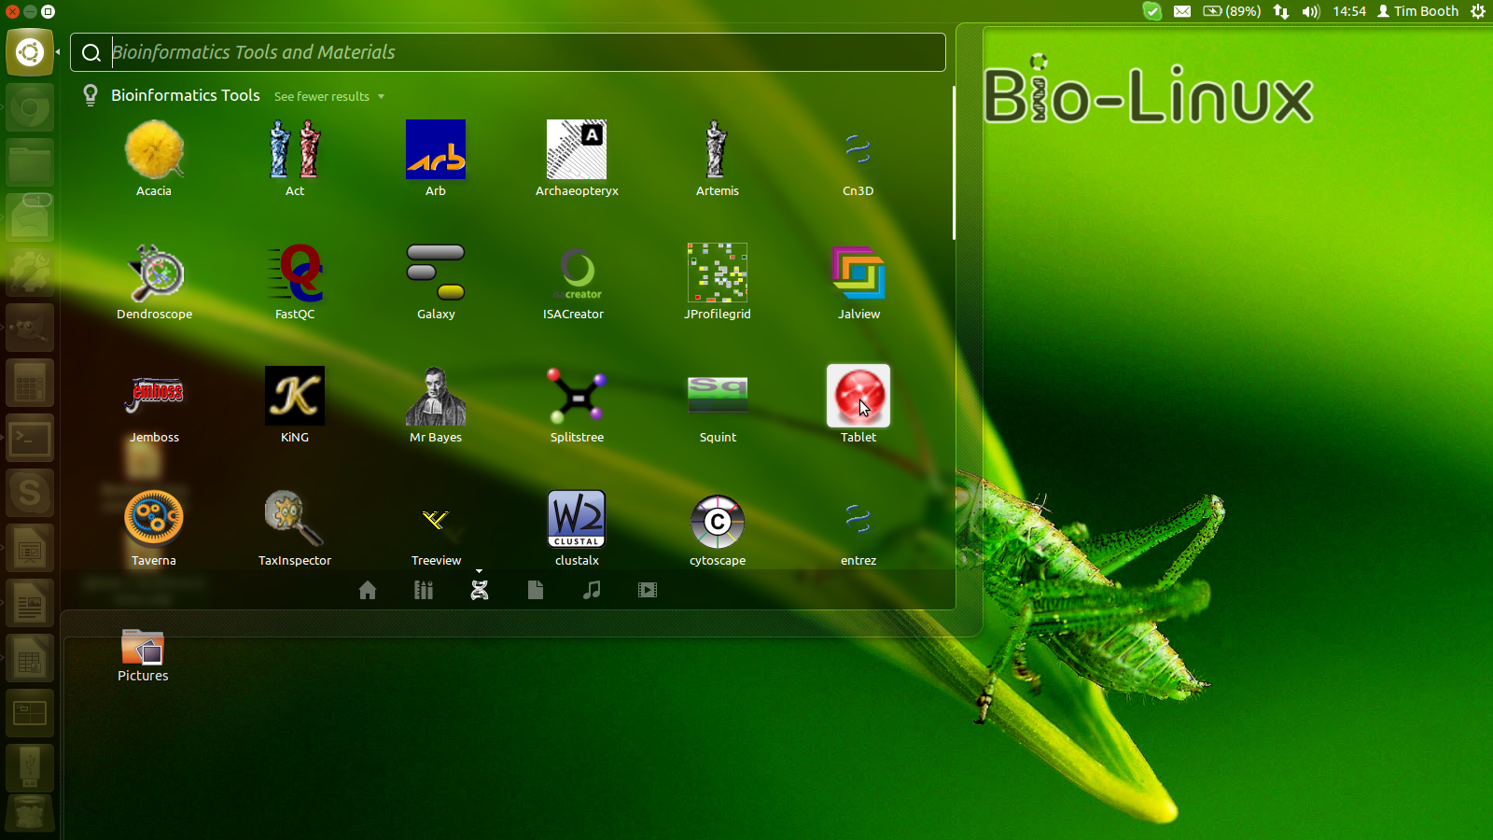
JASMIN Evolution 2) Cloud Architecture
JASMIN Analysis Platform VM
Access for hosted services
CloudBioLinux Desktop with dynamic RAM boost
JASMIN Cloud Management Interfaces
Firewall
Firewall
JASMIN Internal Network
External Network inside JASMIN
Managed Cloud - PaaS, SaaS
Unmanaged Cloud – IaaS, PaaS, SaaS
Appliance Catalogue
Firewall + NAT
Firewall + NAT
another-org
eos-cloud-org
Appliance Catalogue
Web Application Server VM
Appliance Catalogue
CloudBioLinux
Fat Node
Firewall + NAT
Project1-org
Science Analysis VM 0
Science Analysis VM 0
Science Analysis VM 0
Science Analysis VM
Science Analysis VM 0
ssh bastion
Database VM
File Server VM
CloudBioLinux VM
Direct access to batch processing cluster
Direct File System Access
Lotus Batch Compute
Panasas storrage
Standard Remote Access Protocols – ftp, http, …
NetApp storage

Slide 19
Custom Cloud Portal
JASMIN Cloud Management Interface
Building on top of VMware vCloud
Keep it simple: provide just enough functionality to provision and configure VMs
Right tools for right users: scientists, developers and administrators
Abstraction from vCloud also provides a route to cloud federation / bursting
Abstraction layer
vCloud API Client
OpenStack Client
Pub Cloud Client
Implements
0ther clients …
VMware vCloud API

Slide 20
JASMIN Evolution 3)
JASMIN Cloud
How can we effectively bridge between different technologies and usage paradigms?
How can we make most effective use of finite resources?
Storage
‘traditional’ high performance global file system doesn’t sit well with cloud model
Although JASMIN PaaS provides dedicated VM NIC for Panasas access ☺
Compute
Batch and cloud separate – cattle and pets – segregation means less effective use of overall resource
VM appliance templates cannot deliver portability across infrastructures
Spin up time for VMs on disk storage can be slow
Data Archive and compute
Bare Metal Compute
High performance global file system
Virtualisation
Internal Private Cloud
<= Different slices thru the infrastructure =>
External Cloud Providers
Cloud Federation / bursting
Isolated part of the network
Support a spectrum of usage models

Slide 21
JASMIN Evolution 4)
Object storage enables scaling global access (REST API) inside and external to data centre ref. cloud bursting
STFC CEPH object store being prepared for production use
Makes workloads more amenable for bursting to public cloud or other research clouds
Container technologies
Easy scaling
Portability between infrastructures – for bursting
Responsive start-up
OPTIRAD project
Initial experiences with containers and container orchestration

Slide 22
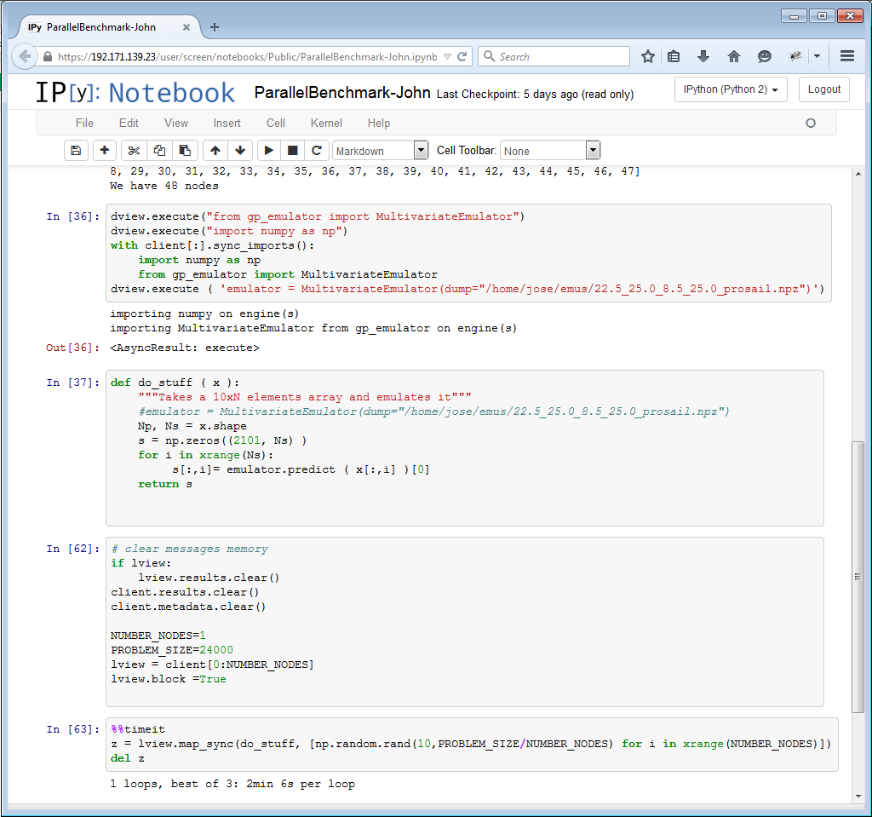
OPTIRAD Deployment Architecture
Browser access
OPTIRAD JASMIN Cloud Tenancy
VM: Swarm pool 0
VM: shared services
VM: Swarm pool 0
VM: Swarm pool 0
NFS
LDAP
Docker Container
JupyterHub
IPython Notebook
VM: slave 0
Firewall
Manage users and provision of notebooks
Kernel
VM: Swarm pool 0
Parallel Controller
Parallel Engine
Kernel
VM: Swarm pool 0
Jupyter (IPython) Notebook
Docker Container
Docker Container
Swarm
IPython Notebook
Kernel
Parallel Controller
Parallel Engine
Kernel
Swarm manages allocation of containers for notebooks
Notebooks and kernels in containers
Nodes for parallel Processing

Slide 23
Challenges for implementation of Container-based solution
Managing elasticity of compute with both containers and host VMs
Extend use of containers for parallel compute
Which orchestration solution? – Swarm, Kubernetes . . .
Provoked some fundamental questions about how we blend cloud with batch compute . . .
Apache Mesos
The data centre as a server
Blurs traditional lines between OS and host app and hosting environment with use of containers
Integrates popular frameworks in one: Hadoop, Spark, …
Managing elasticity of storage
Provide object storage with REST API – CEPH likely candidate with S-3 interface
BUT users will need to re-engineer POSIX interfaces to use flat key-value pair interface of object store

Slide 24
Further information
JASMIN:
http://jasmin.ac.uk/
EO Science From Big EO Data On The JASMIN-CEMS Infrastructure, Proceedings of the ESA 2014 Conference on Big Data from Space (BiDS’14)
Storing and manipulating environmental big data with JASMIN, Sept 2013, IEEE Big Data Conference, Santa Clara CAhttp://home.badc.rl.ac.uk/lawrence/static/2013/10/14/LawEA13_Jasmin.pdf
OPTIRAD:
The OPTIRAD Platform: Cloud‐Hosted IPython Notebooks for Collaborative EO Data Analysis and Processing, EO Open Science 2.0, Oct 2015, ESA-ESRIN, Frascati
Optimisation Environment For Joint Retrieval Of Multi-Sensor Radiances (OPTIRAD), Proceedings of the ESA 2014 Conference on Big Data from Space (BiDS’14) http://dx.doi.org/10.2788/1823
Deploying JupyterHub with Docker:
https://developer.rackspace.com/blog/deploying-jupyterhub-for-education/

